Slide 1
Elaboration 3
Trippin
Tong , Lauren , Lenneth, Fahim, Abdullahi

Slide 2
Table of Contents
Vision and Scope
Business Value
Updated Use Case Diagrams
Client Use Case
Admin Use Case
Domain Model (Updated)
Class Diagram (Updated)
Software Architecture Document
Data Model
Sequence Diagrams
Registering Sequence
Login Sequence
Logout Sequence
Client Sequence
GRASP
Creater, Controller, and Expert
GoF
Adaptor/Poly
Strategy
“Prototype”

Slide 3
Vision & Scope
Vision
To create an app that displays the cheapest trip for commuters. This app will compare prices of metro transit, uber, lyft and taxis. Its would update in real life and be useful to the money contentious commuter.
Scope
With the use of GPS, we will utilize the information that available to display the pricing of each type of transportation so the user can choose their trip accordingly to their schedule.

Slide 4
Business Value
Provide the cheapest price for a ride
Decrease customer spending
Maintain high reputation
Maximize customer lifetime
Help with traffic congestion
Reduce carbon emissions
Provide awareness to other modes of transportation

Slide 5
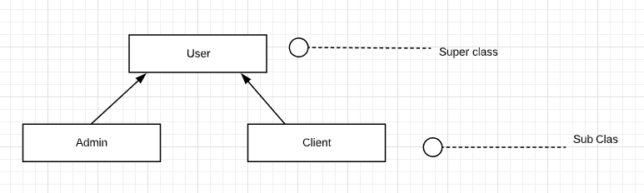
Implementing Superclass & Subclasses

Slide 6
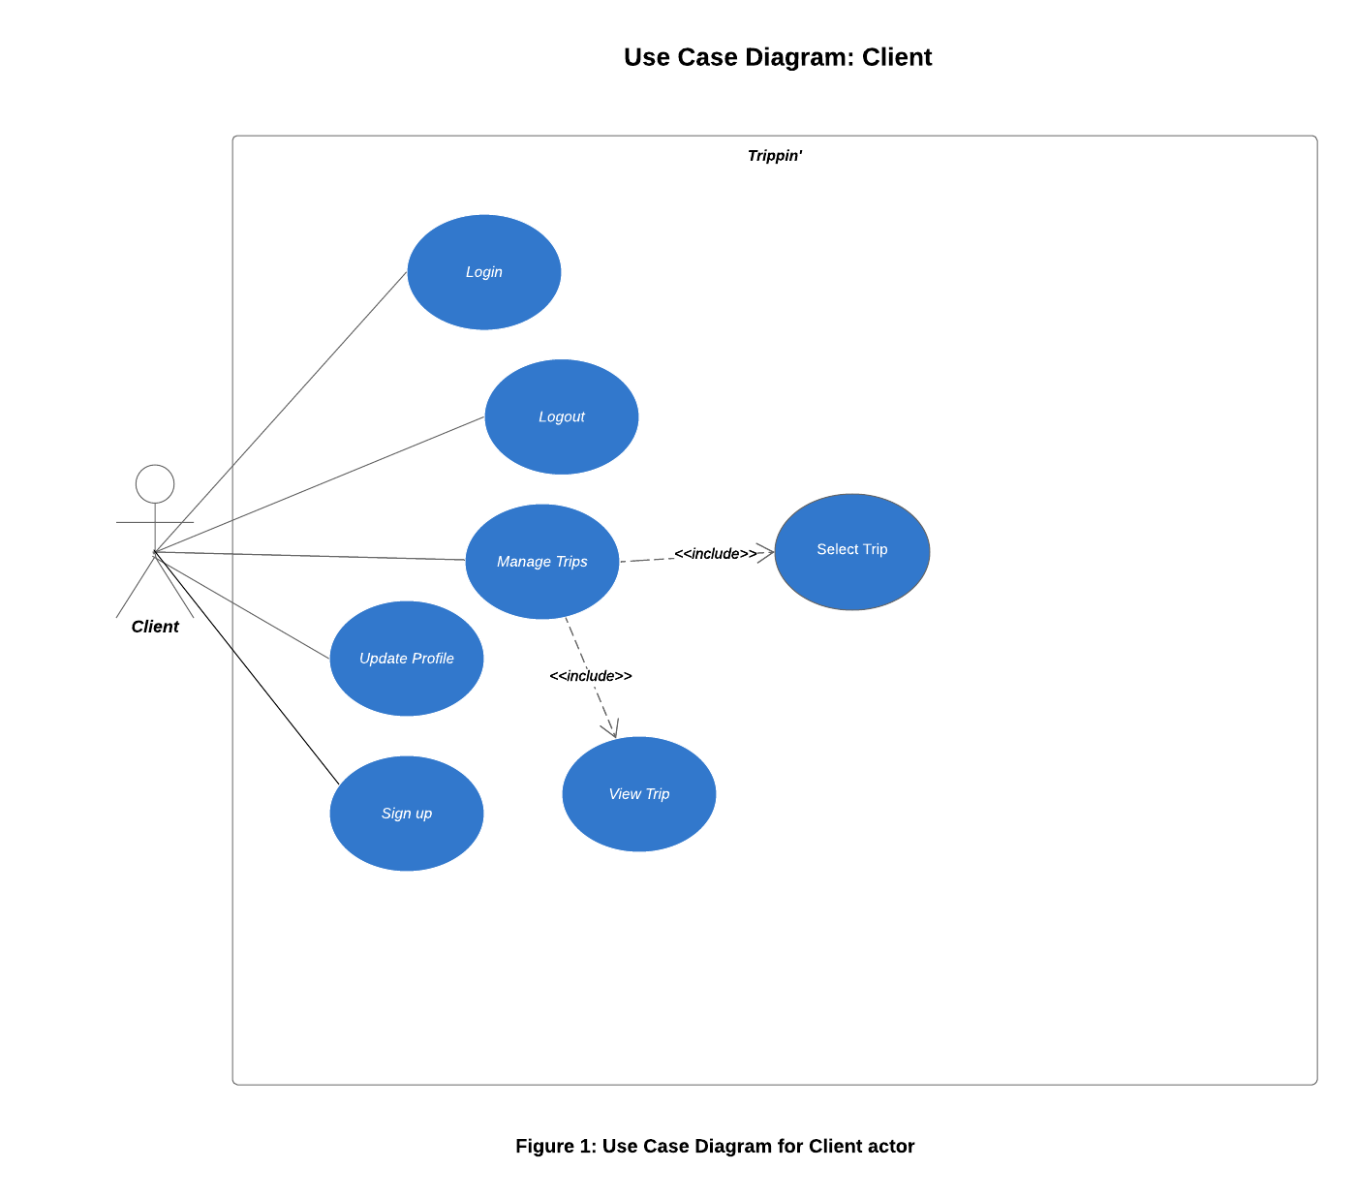
Client Use Case Diagram

Slide 7
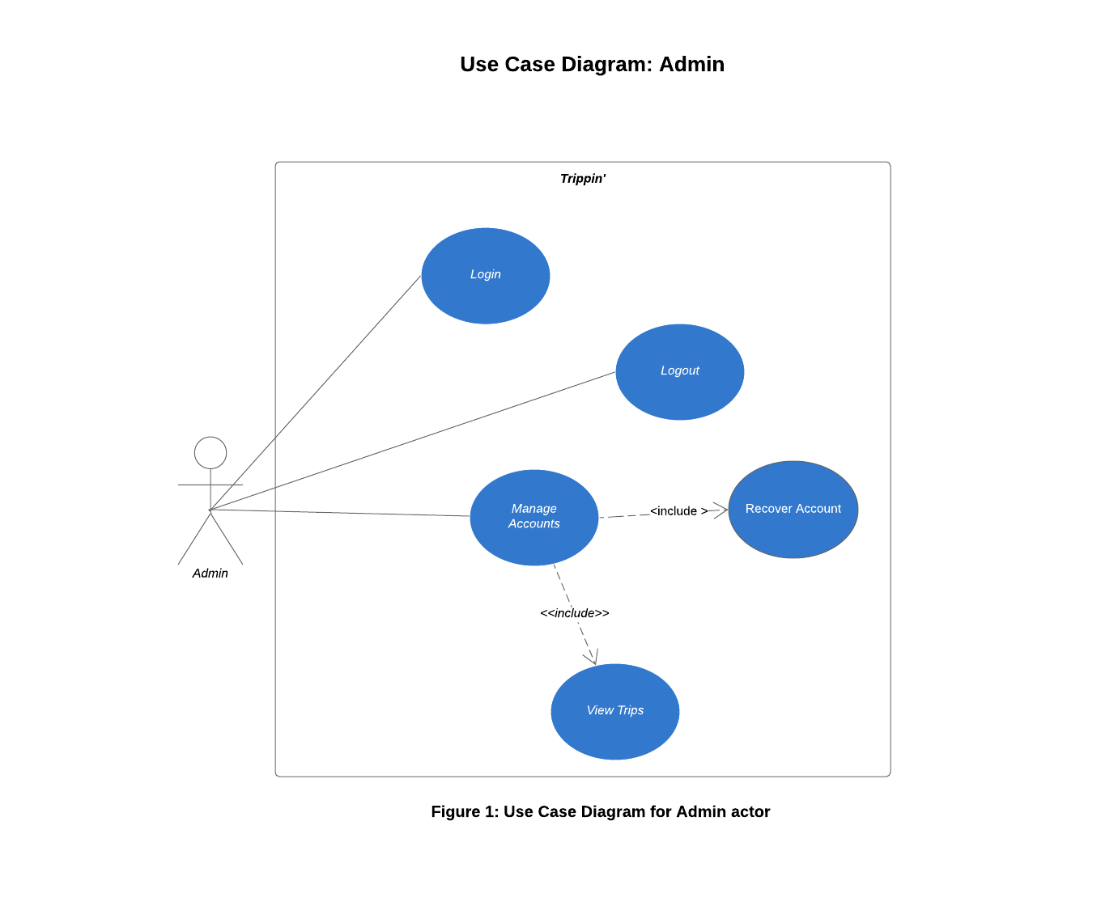
Admin Use Case Diagram

Slide 8
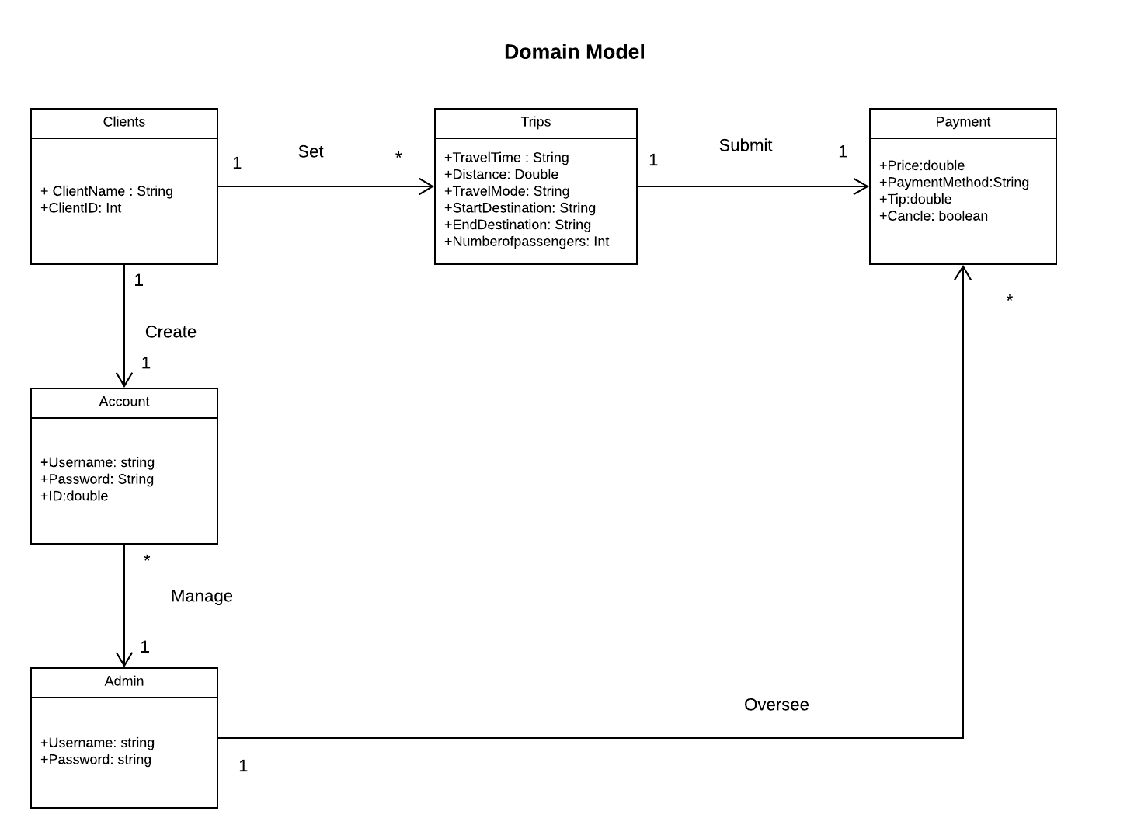
Trippin’
Domain
Model

Slide 9
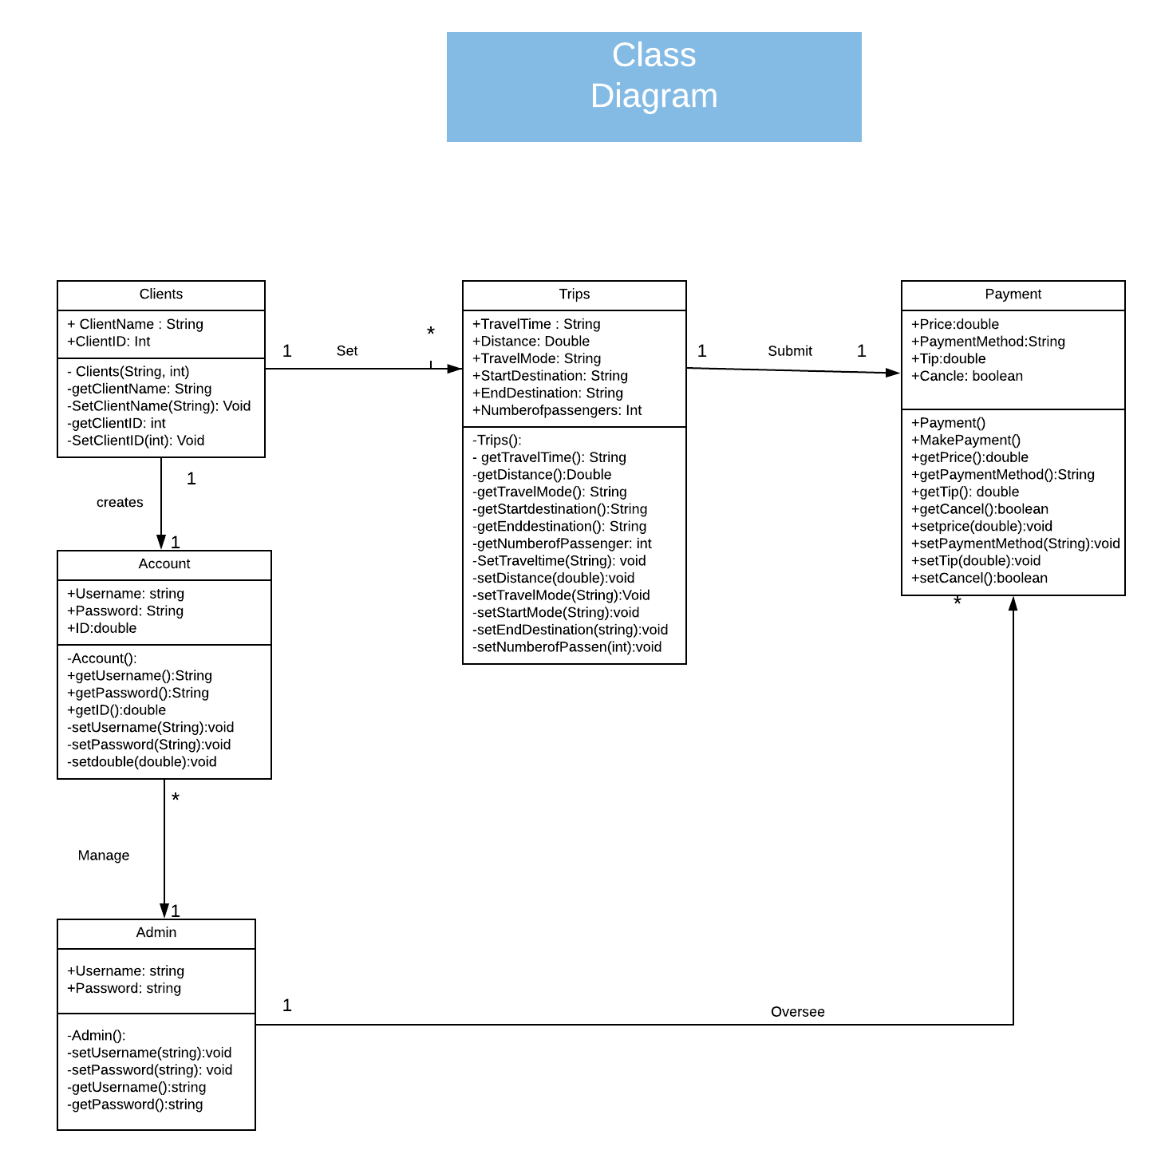
Class
Diagram

Slide 10
Software Architecture Document
Purpose
The purpose of this document is to show a comprehensive overview of the application. It will use a number of artifacts to convey the different parts of the app processes.
Scope
This Software Architecture Document applies to the Trippin Application that will be developed by Trip (Change/Edit ) Inc.
Architectural Representation
This document presents the architectural as a series of views; use case view, process view, sequence views, and implementation view. These views will be presented as UML diagrams and SSD’s.
Architectural Goals and Restraints
The application must be able to handle multiple transactions and large amount of traffic.
All functions must be available on the app and are working correctly.
All credit card, financial transactions, and user information must be transmitted securely.
Ensure database consistency in terms of pick up location and times.

Slide 11
Software Architecture Document Cont.
Logical View
This view contains some of the most important classes and a brief description of each class.
User:
Contains class for information provided by actors used for updating accounts, making payments, and viewing trips. It should also contain classes for provided feedback.
Administrator:
Contains classes for content management and profile management.
Investor:
Contains classes for Trip management and view.
Process View
Describes the tasks involved in the use of the Trippin Application, the interaction with the server, and interactions with third party service providers.

Slide 12
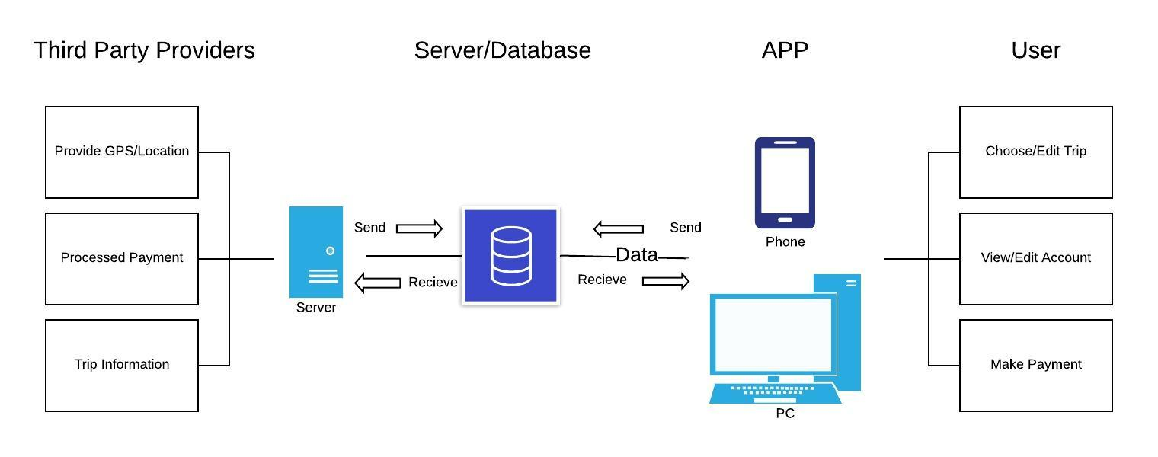
Software Architecture

Slide 13
Data Model
Class | Attributes | Data Type
Client | ID Name Phone Number Email | Int String Int Varchar (30)
Administrator | Username Password | Varchar (10) Varchar (30)
Account | Username Password ID | Varchar (10) Varchar (30) Int

Slide 14
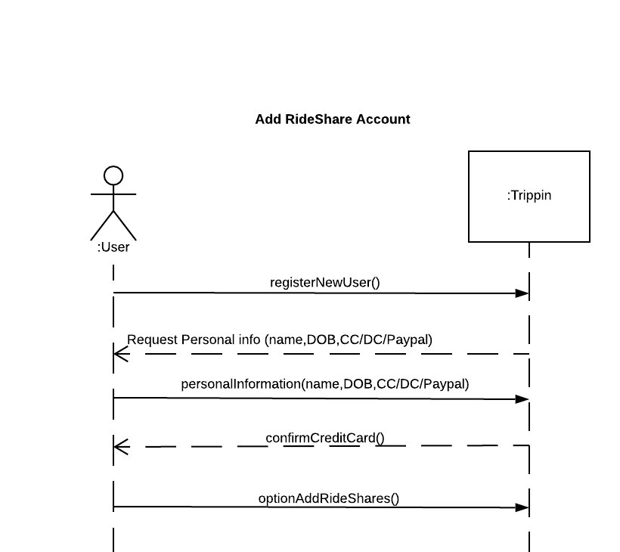
SSD for Add RideShare Account Use Case

Slide 15
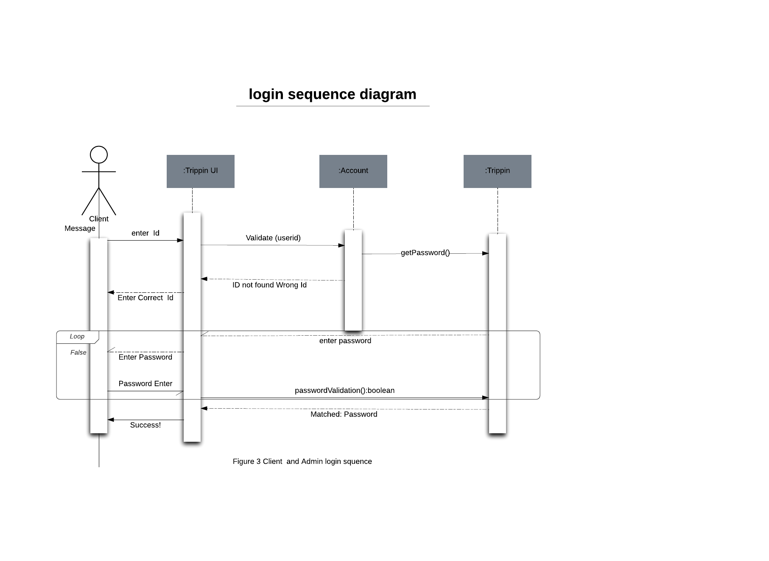
Login Sequence

Slide 16
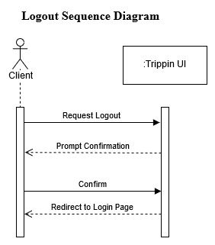
Logout Sequence Diagram

Slide 17
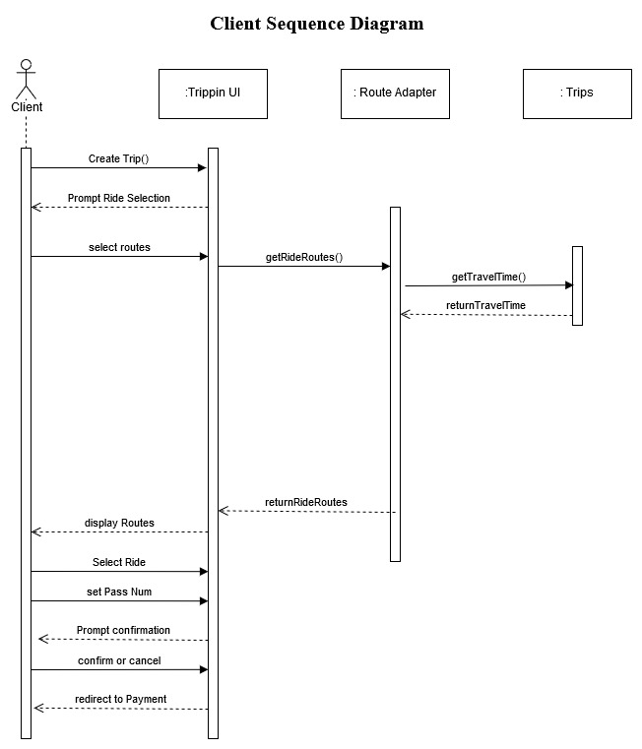
Client Sequence Diagram

Slide 18
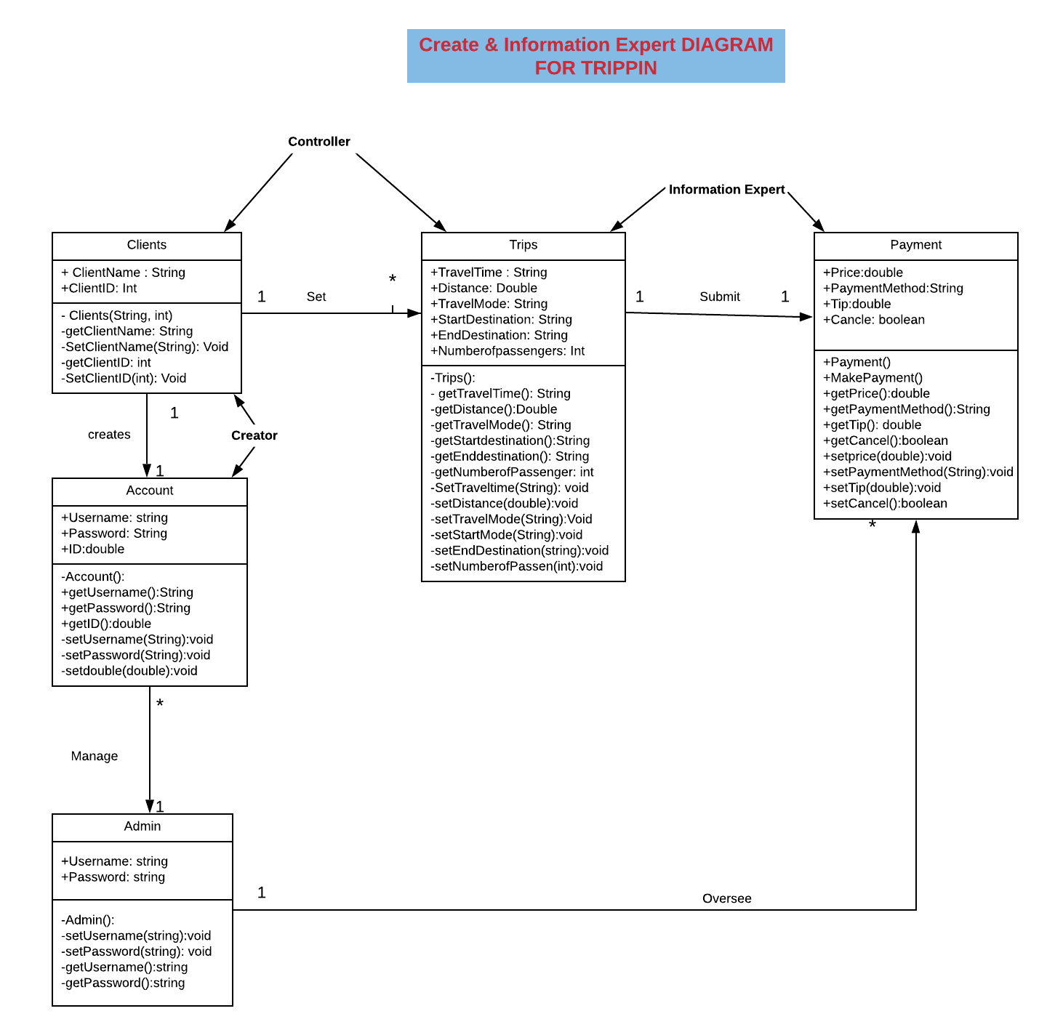
Creator & Information Expert Diagram for TRIPPIN

Slide 19
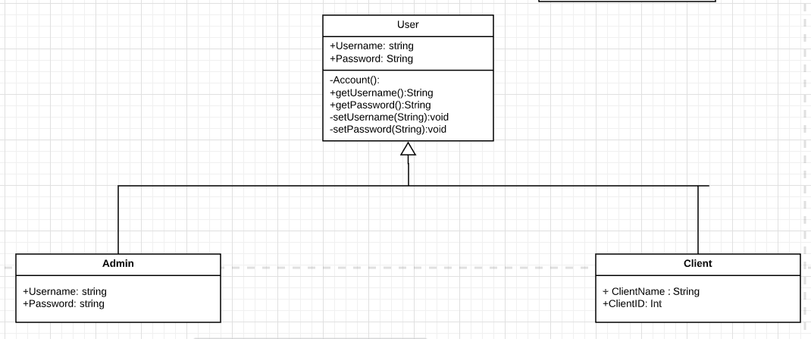
GRASP Polymorphism Diagram

Slide 20
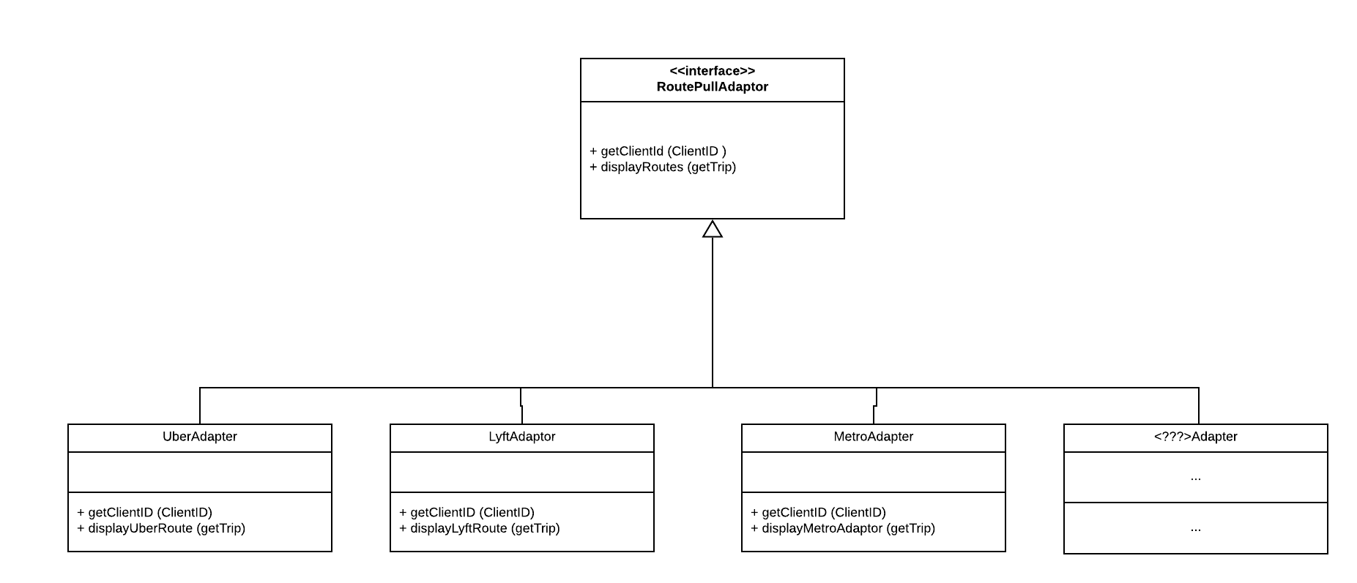
Adaptor/Polymorphism

Slide 21
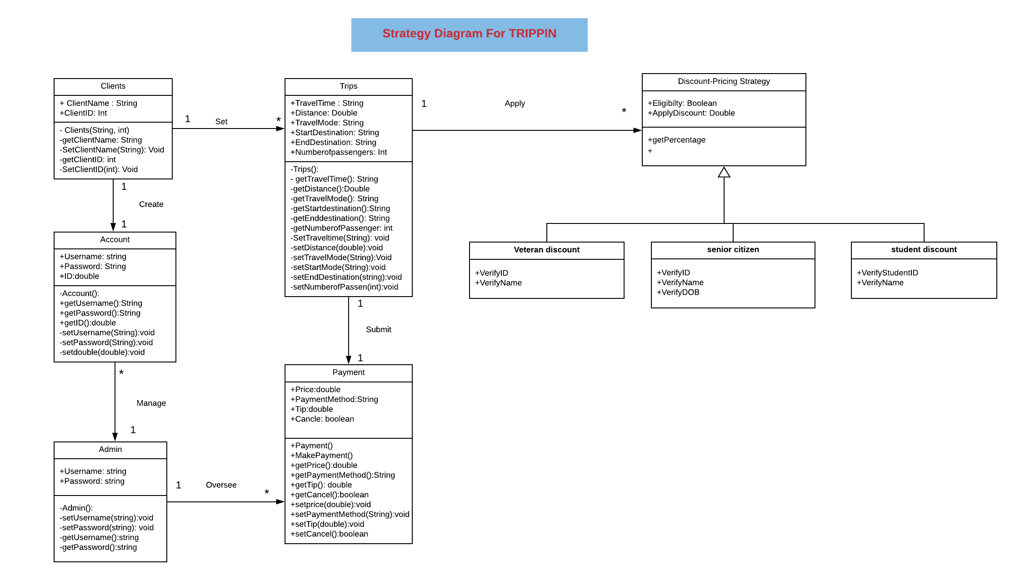
Strategy Diagram for
Trippin

Slide 22
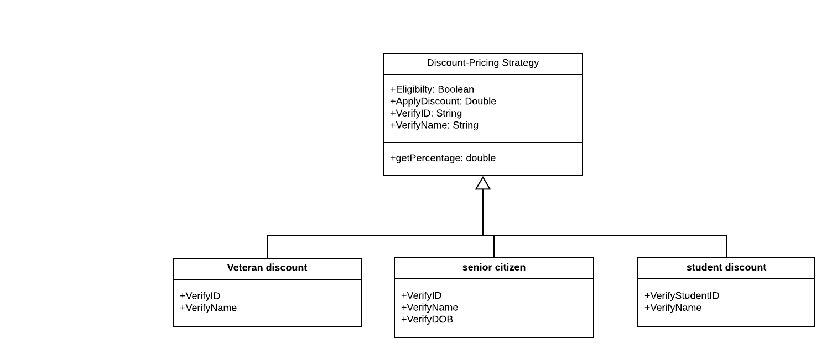
Strategy Diagram for Trippin cont.

Slide 23
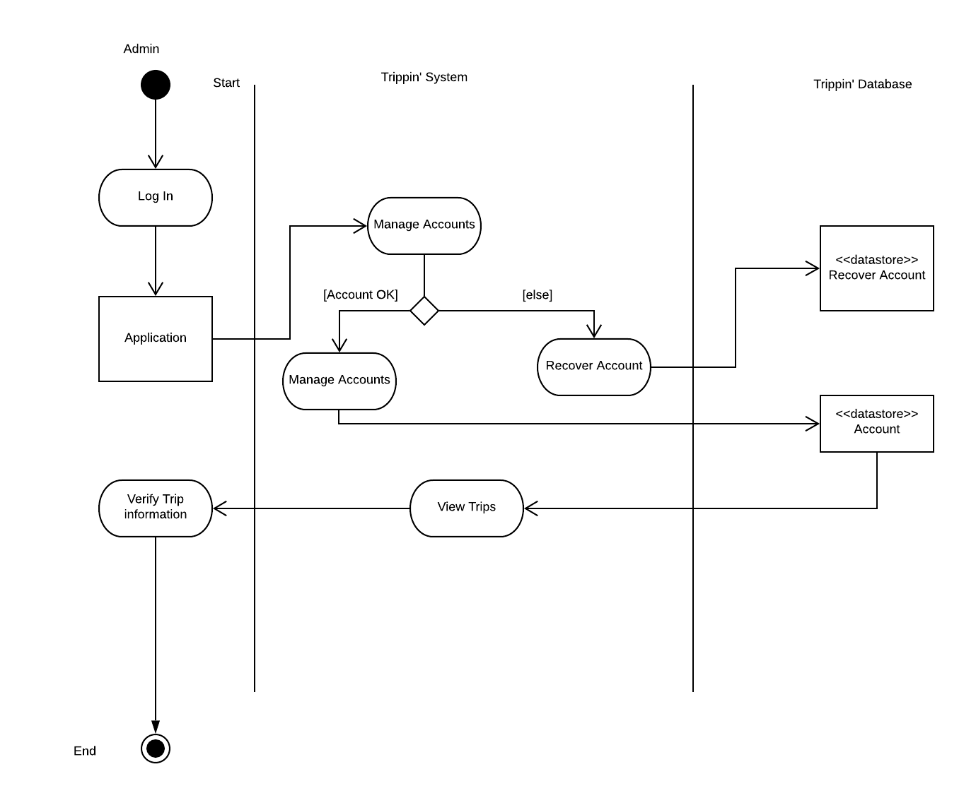
Admin Activity Diagram

Slide 24
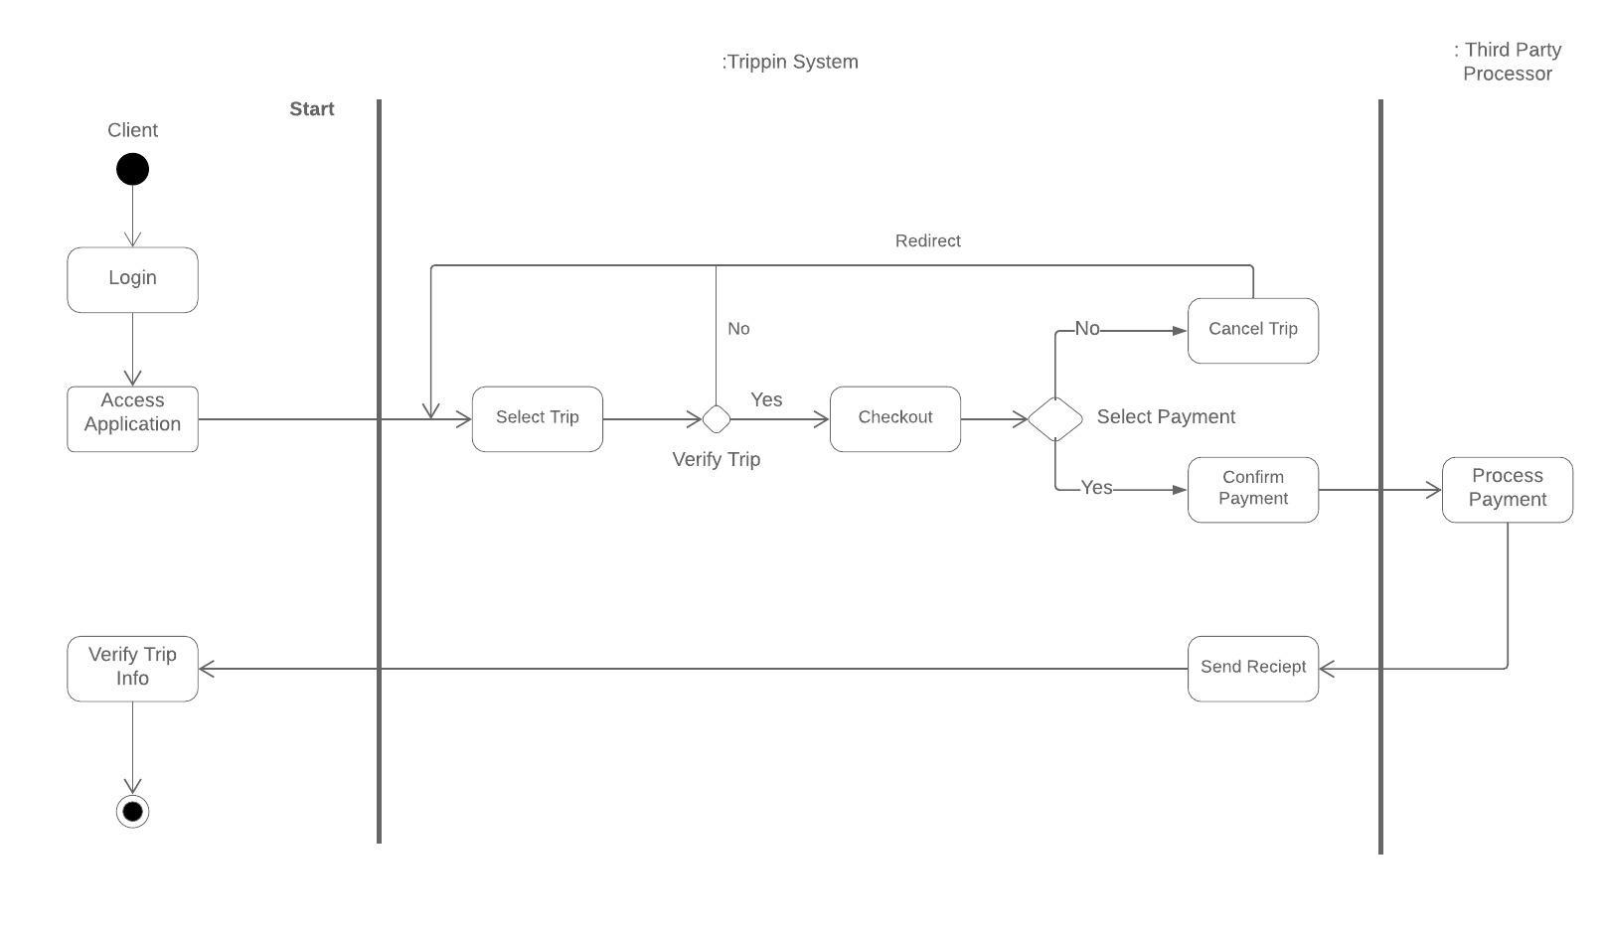
Trip Select Activity Diagram

Slide 25
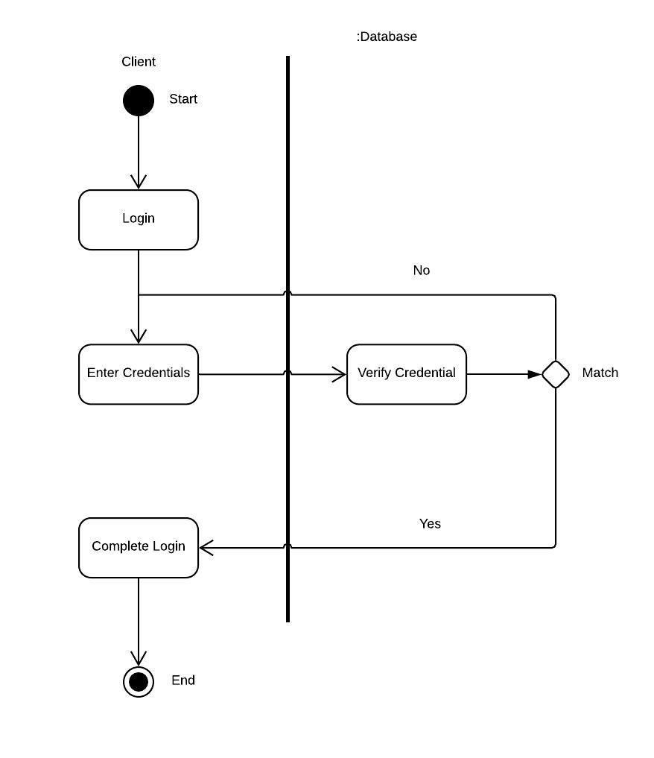
Client Login Activity

Slide 26
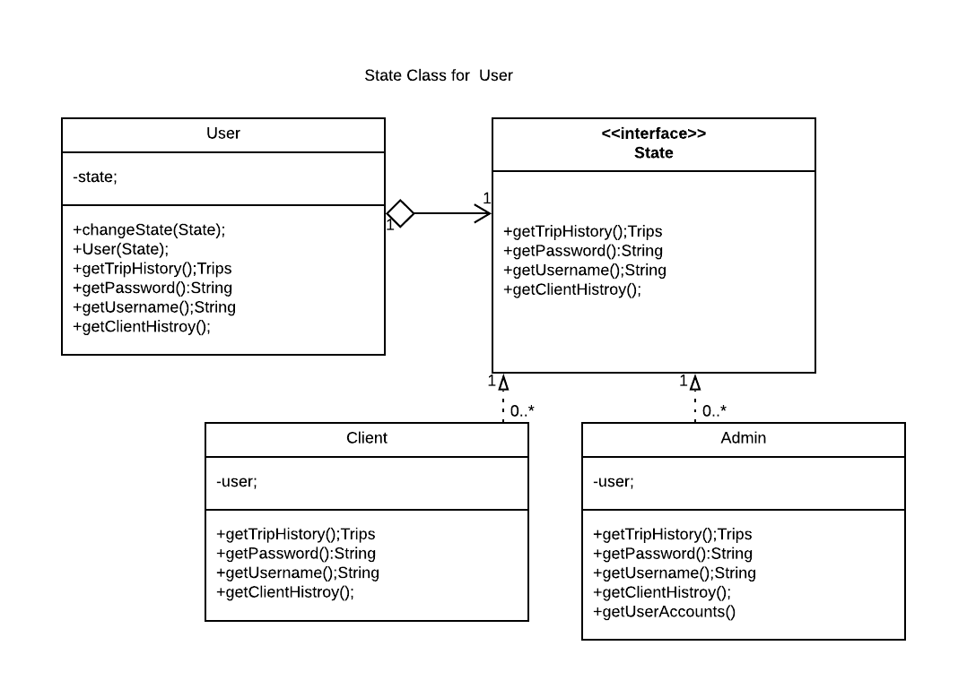
User State Class Diagram

Slide 27
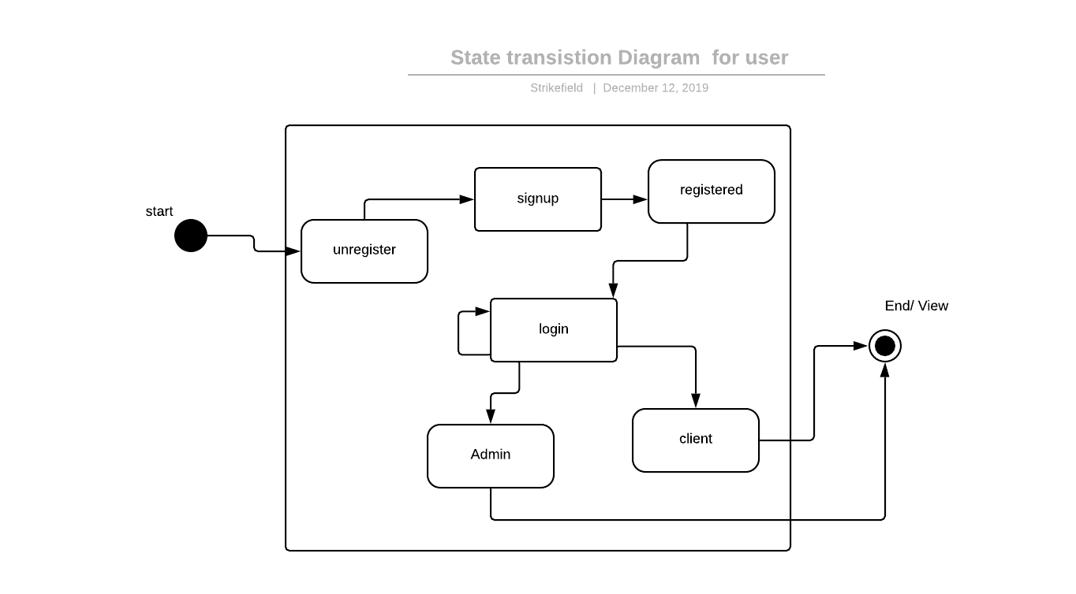
State Diagrams

Slide 28


